Slide 1
climate change effects on global health
Summer Training Final Project
Roll no. - 2405043242
Date: 3/July/2026
Arshveer Singh / B.tech Blockchain
Guided by: DR.ashima, Ms.Mandeep Kaur

Slide 2

Agenda
Problem Statement & Objective
Dataset Overview
Dashboard
Key Findings
Conclusion

Slide 3
overview

Slide 4
Problem statement & Objectives
Problem Statement:
Target Users:
The changes in climate because of development, global warming and more affects atmosphere in many different ways and it causes anomalies which in result causes different types of diseases and issues for humans health.
Health Boards
Hospitals
Elders
Climate Researchers
Project Objectives:
Check if its clean using python (Numpy, Pandas) and analyse the dataset
Make Excel pivot tables and visuals for better understanding of relations between columns
Create DAX measures needed for understanding the data better
Design a dashboard with all the essential charts for understanding the dataset
Publish the final project

Slide 5
Dataset overview
Source
File Type
Rows
Columns
Kaggle
CSV
14100
30
Key Columns
Column | Role
Country name | Used for representing Countries
Year | Used for comparing the timeline
Healthcare access | How much people had access to Healthcare in different countries
Income level | Categorising the countries on the income level of People
Food security | The security of Food quality in the country
Temperature Anomalies | The increase in temperature then the average predicted

Slide 6
Dashboard

Slide 7
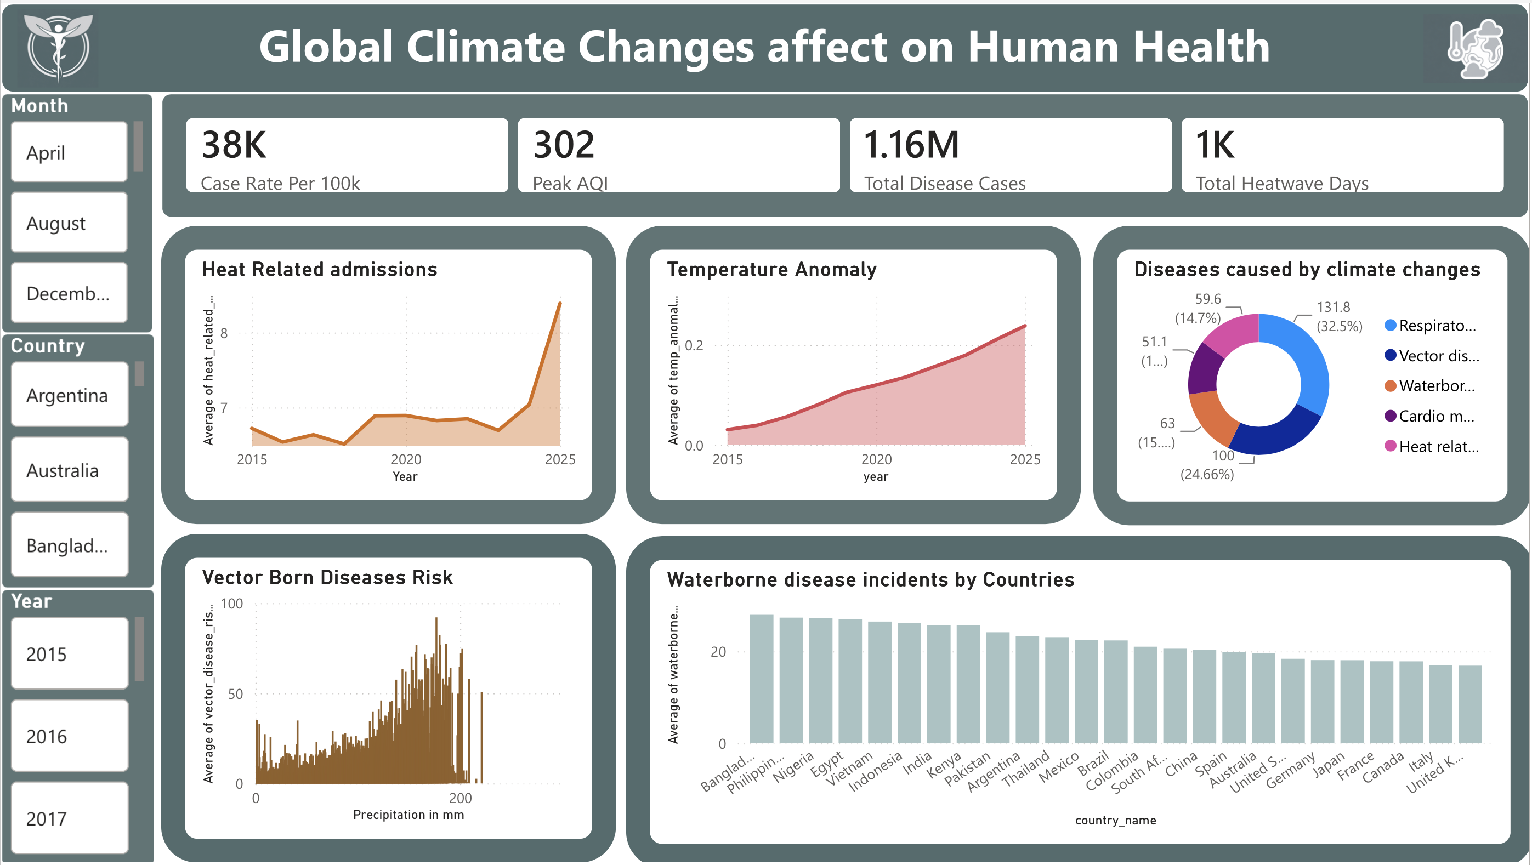

Slide 8
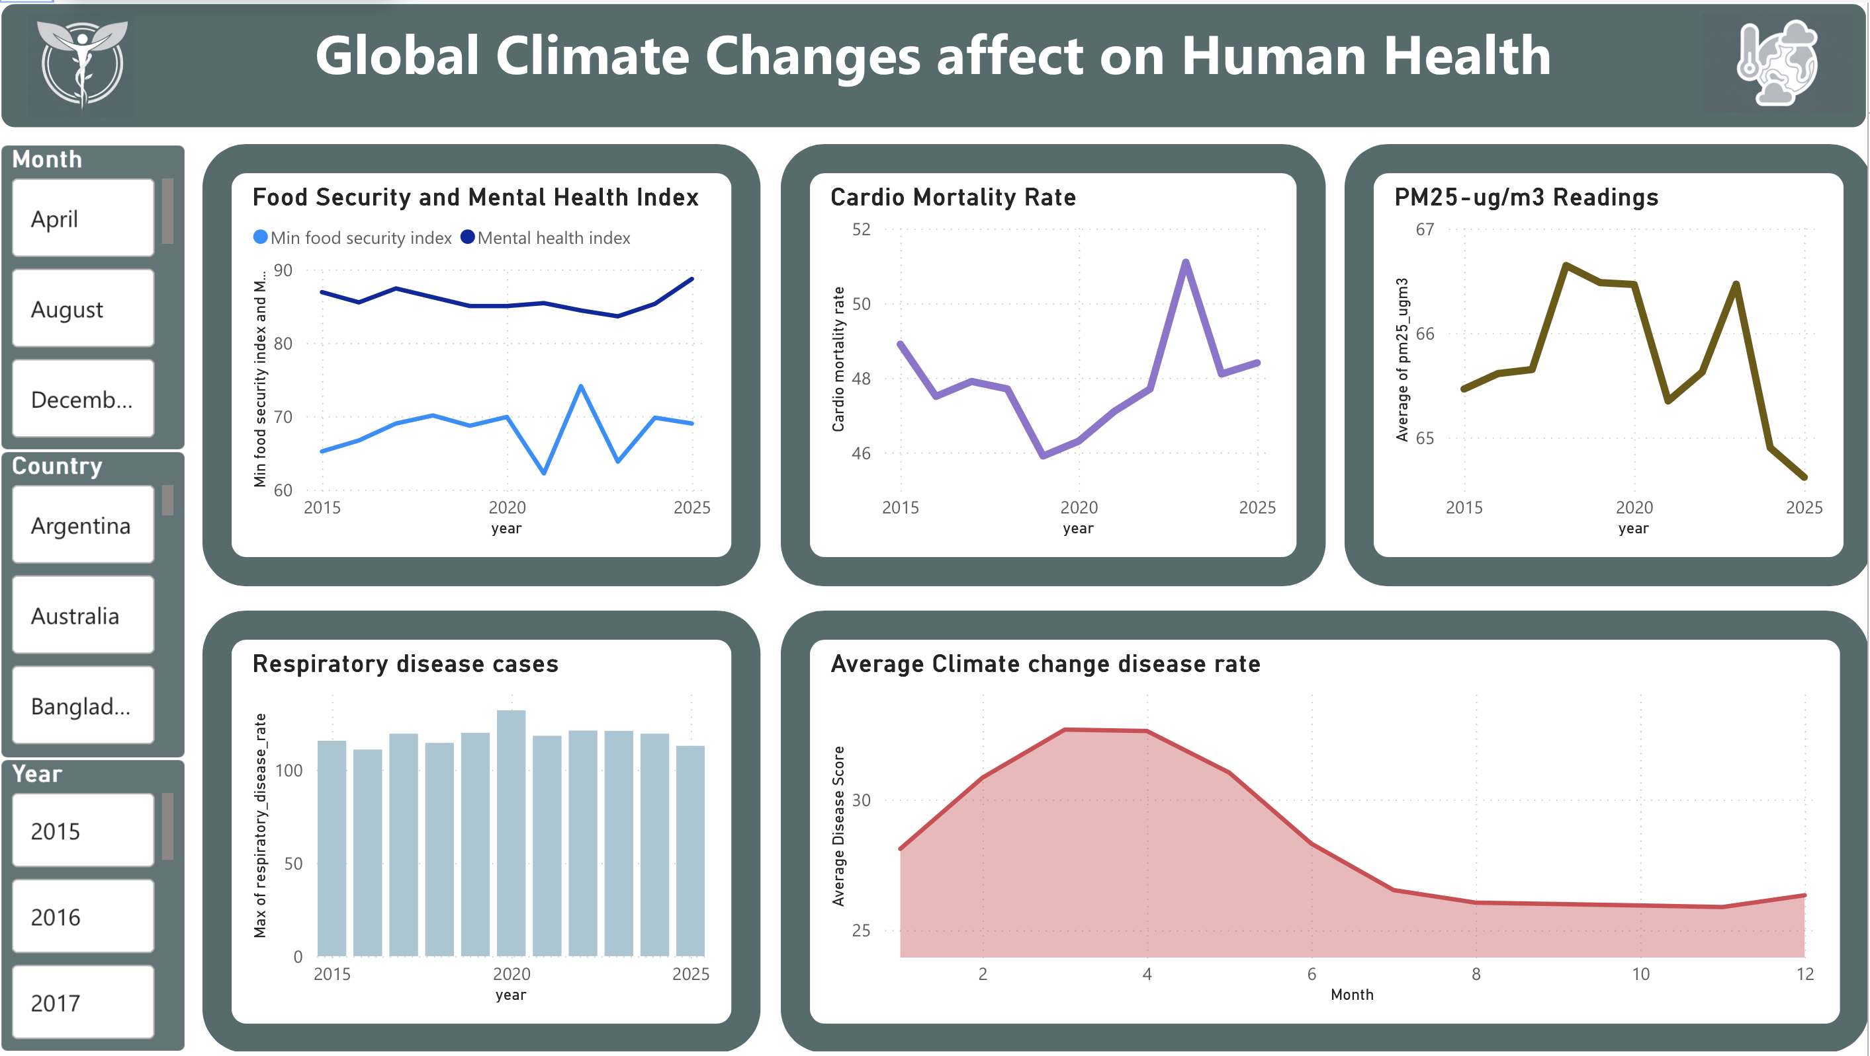

Slide 9
Key Findings

Slide 10
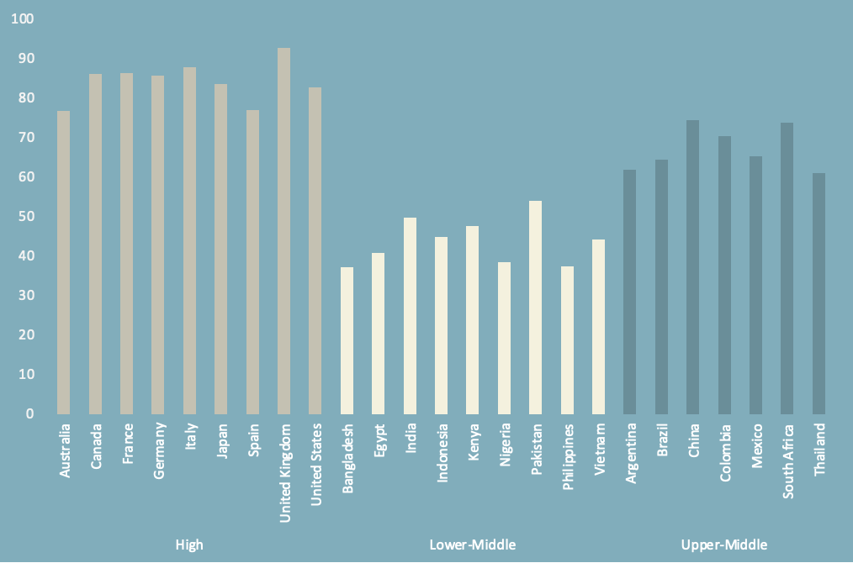
Healthcare access in countries
The Healthcare Access VS Countries graph has income levels based grouping
The Graph shows that High and Upper-middle Income level countries have the best healthcare access.
The Lower-Middle income level countries have low access to healthcare reaching upto average of 60 only.

Slide 11
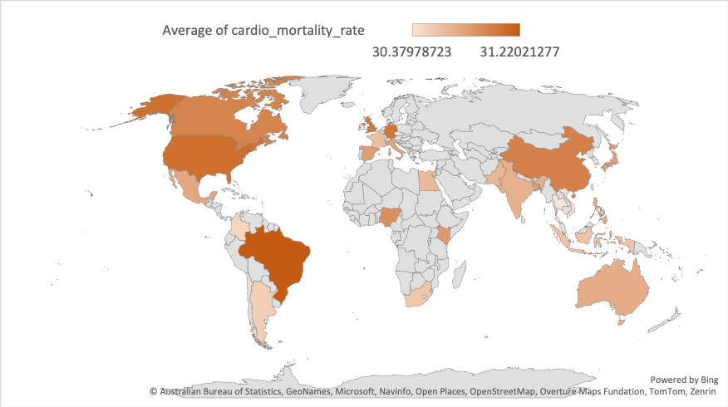
Cardio Mortality Rate
This map shows that Brazil has the highest (31.22%) Heart related deaths rate and Thailand has the lowest (30.37%) cardio mortality rate.

Slide 12
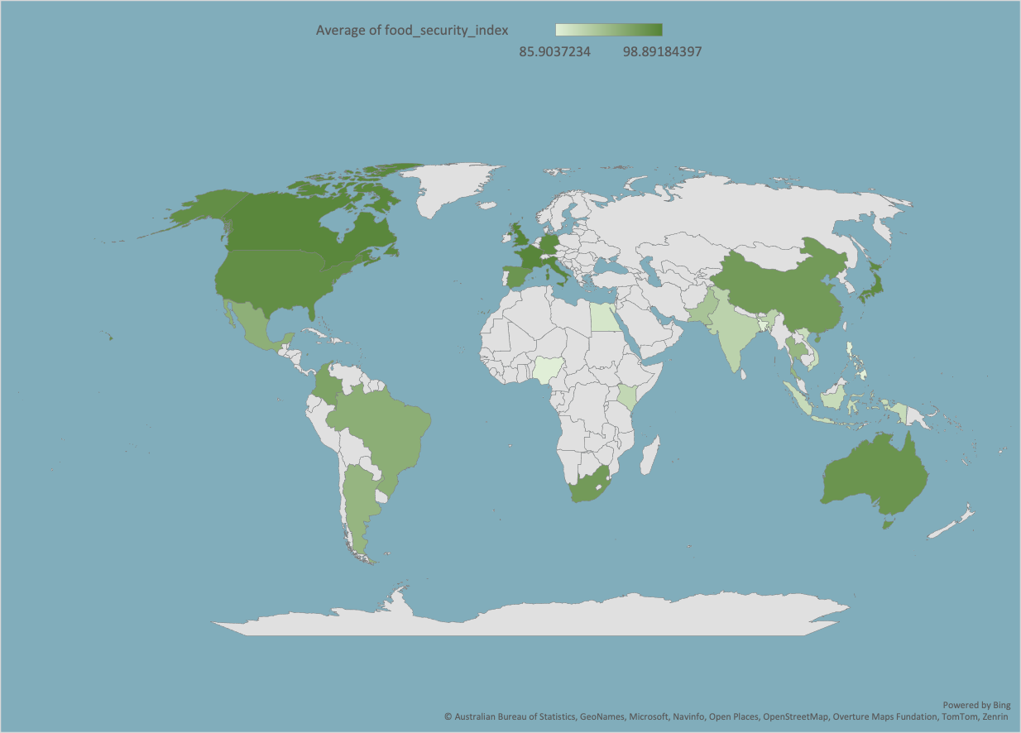
Food security of countries
This map shows that UK has the highest (98.9) food security index and Philippines have the lowest (85.9) food security index

Slide 13
Key findings & insights
Respiratory diseases cases were the most compared to other diseases.
The highest AQI that was recorded globally between 2015 to 2025 was ‘302’.
The spring season showed the most hike in climate change diseases cases in the decade of 2015 to 2025.
The VectorBorne Diseases major increase when Precipitation crosses 110 mm
The data shows that the Cardio Mortality showed sudden hike with the hike in PM2.5-ug/m3 ratings in 2023.
The data showed steady increase in the average temperature globally from 2015 to 2025.
Average PM25-ug/m3 readings show a decrease in 2025 (64.6) since 2015 (65.4).
The data shows that the Healthcare access varies with the income level of the countries as High income level countries had an average of 85 access and low middle countries had an average of 45 access.
Heat related admissions have increased massively in 2025 since 2015.

Slide 14
Conclusion & thank you
Analysed and visualised the effects of climate anomalies on
global health and disease trends and it can be seen that global temperature
has increased steadily since 2015 and healthcare access in countries varies
with their income levels(High, Upper-Middle and Lower-middle).

